Slide 1

Welcome to the Agent Development Kit (ADK)
Daniel Benner Partner Technical Specialist - Partner
dbenner@us.ibm.com
512.825.6186

Slide 2
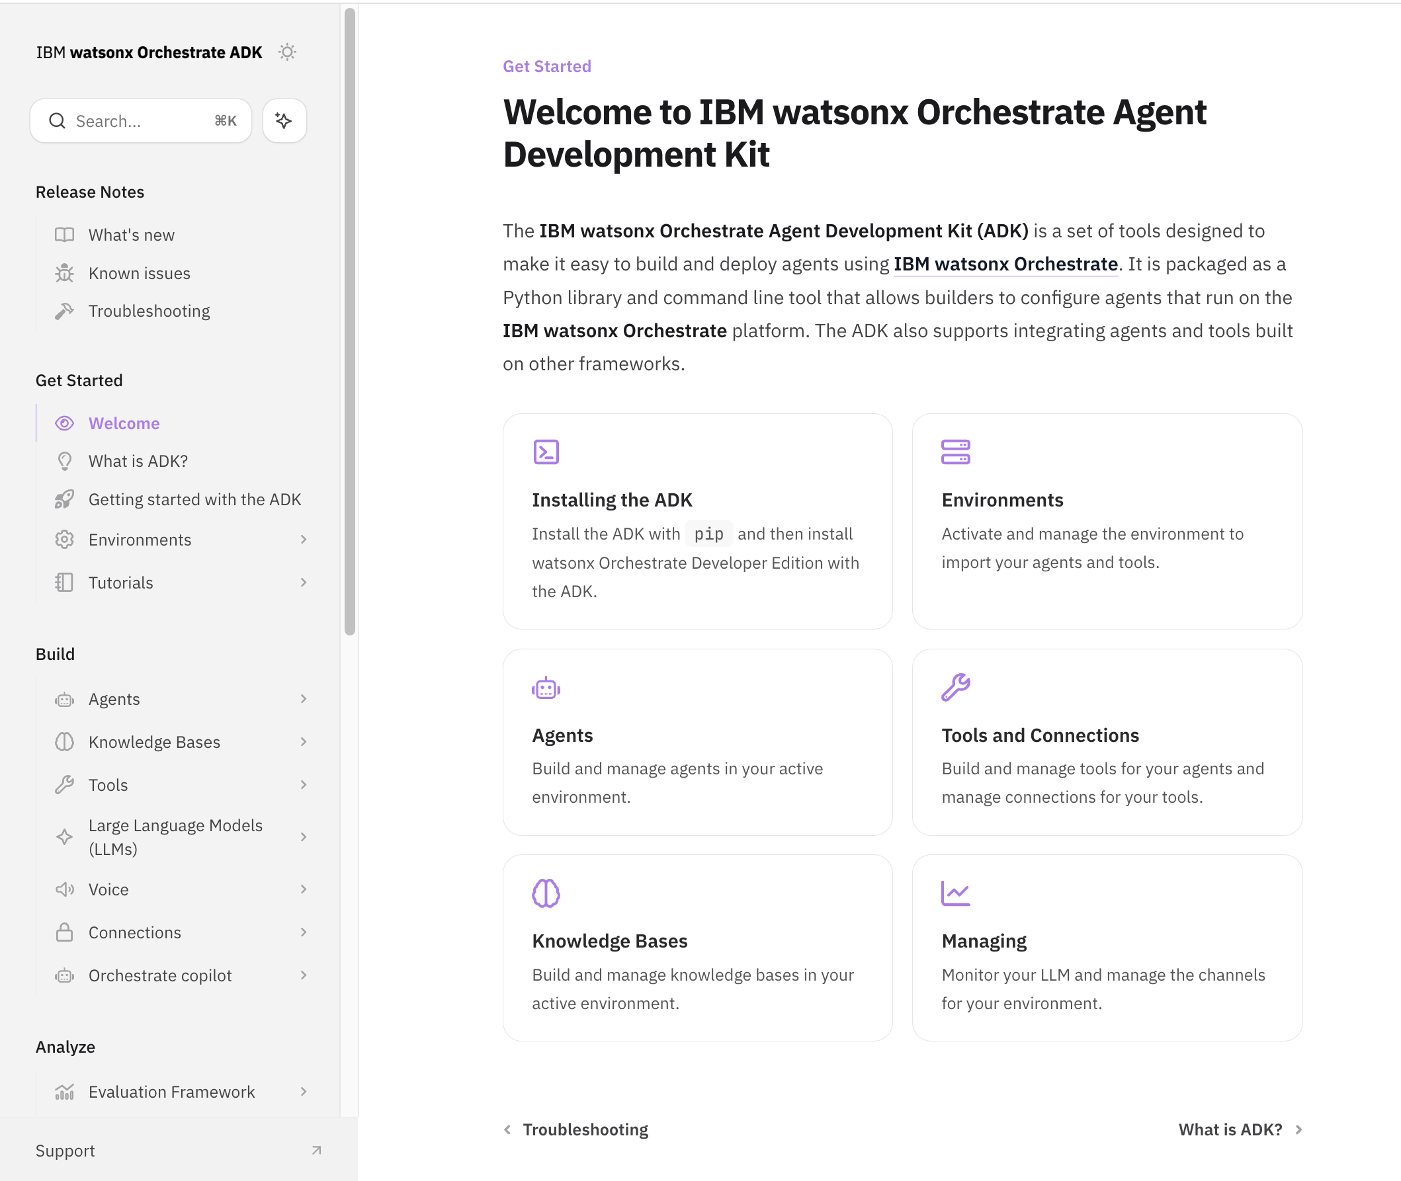
What is the watsonx Orchestrate ADK
“Pro code” tools to develop agents and tools for use across different watsonx Orchestrate offerings, including:
watsonx Orchestrate AWS
watsonx Orchestrate IBM Cloud
watsonx Orchestrate on-premises
watsonx Orchestrate Developer Edition
Notes:
What's in it for you? Well several major things:
1. Build custom demos for your customers with more control, speed, and repeatability.
2. Engage your customer's IT organization in the devops methodology for watsonx Orchestrate solutions
3. Build locally, on your laptop, then deploy to any watsonx Orchestrate offering or as technical folks would say deployment target like orchestrate on AWS, IBM Cloud, on-premises
This last environment, Developer Edition, is what you will be getting comfortable with in this workshop.

Slide 3
Ready, set, go with ADK
Notes:
You are at the Ready stage now so let's get set to go with ADK.

Slide 4
Let’s do a readiness check
workshop Slack
watsonx Orchestrate on IBM Cloud
Internet
All Day 1 and Day 2 labs can be done here
wxO
Chat UI local
Laptop
Microsoft VS Code
wxO Agent Development Kit (ADK)
wxO Developer Edition
UV
Git
You
Notes:
You will need to

Slide 5
Let’s do a readiness check
wxO Advanced Workshop Slack
Get email with link to join wxO Advanced Workshop Slack channel
Open the wxO Slack channel
This is where we will post all the assets you need for this workshop.
Lab guides and code
Presentations
Sensitive information (i.e. API keys)
workshop Slack
watsonx Orchestrate on IBM Cloud
Internet
https://join.slack.com/t/wxoadvanced/shared_invite/zt-3ciuuu4bn-STT_2w6v5GnHnlyPw3iZ~A
Laptop
Agent Development Kit (ADK)
wxO Developer Edition
Microsoft VS Code
Git (optional)
You
Notes:
Let’s make sure everyone has the workshop Slack channel up. As you can see we will use this Slack channel for pushing content to you during the workshop.
ACTIVITY: everyone post a “hello world” message to the Slack channel.

Slide 6
Let’s do a readiness check
Your individual watsonx Orchestrate tenant (OPTIONAL)
You will be using an individual wxO tenant for this workshop.
You will receive a welcome email.
Log in with your IBM id.
You will have access to this environment until Sept 17th then ALL DATA and ENVIROMENTS will be DELETED.
workshop Slack
watsonx Orchestrate on IBM Cloud
Internet
Laptop
You
Notes:
Most of the labs will be done using the Developer Edition, which we’ll talk about more in just a minute.
However, if you are having any issues with the Developer Edition install then we are also providing each of you with your own watsonx Orchestrate environment. This is on purpose to keep you focused on the lab exercises without distractions of a heavily used environment like the TDSynnex watsonx Orchestrate environment.
IMPORTANT: These environments will be deleted on September 17th.
So keep that in mind as you will NOT have access to it once it is DELETED. I’ll be deleting all these environments promptly on September 18th at 8AM CT.

Slide 7
Let’s do a readiness check
wxO Advanced Workshop laptop applications
We will be using VS Code extensively for the labs
The wxO ADK is the “pro code” side for wxO developers
The wxO Developer Edition try out your agents on your own laptop
workshop Slack
watsonx Orchestrate on IBM Cloud
Internet
Laptop
Microsoft VS Code
wxO Agent Development Kit (ADK)
wxO Developer Edition
UV
Git
You

Slide 8
Let’s warm up on VS Code

Slide 9
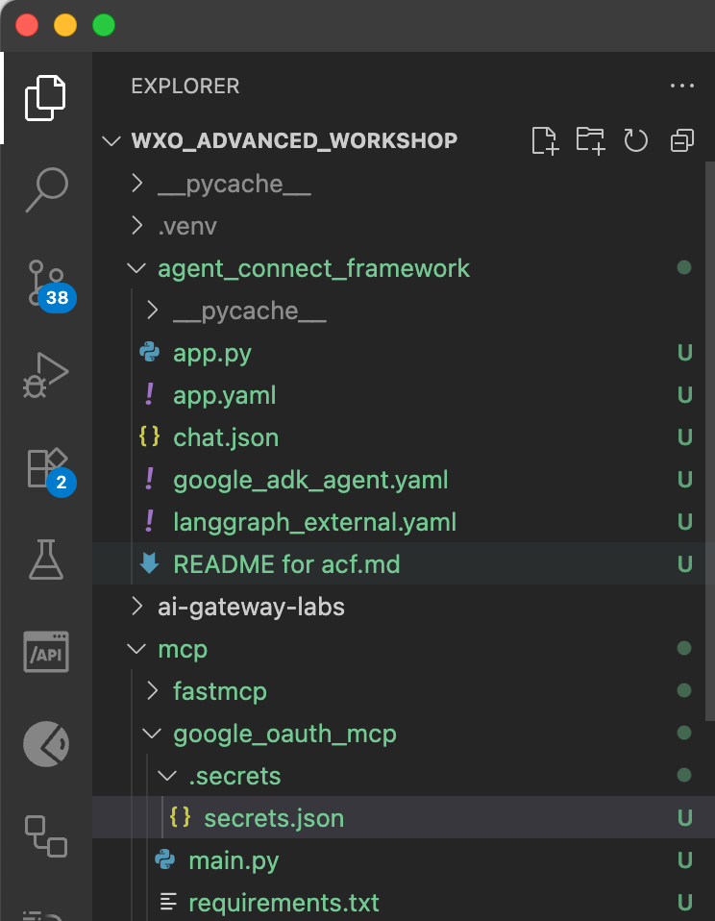

VS Code
Warm up 1
VS Code is great for helping us to navigate our code files
STEP #1:
From the Github, download the wxO_Advanced_labs.zip file, move it to a fresh folder on your laptop, double click the zip file to expand the folder structure.
STEP #2:
Open VS Code, then select File > Open Folder... and find the wxO_Advanced_labs folder you expanded in the previous step.
STEP #3:
Use the VS Code Explorer button/icon (hint, it’s this icon ) to explore the lab files.

Slide 10
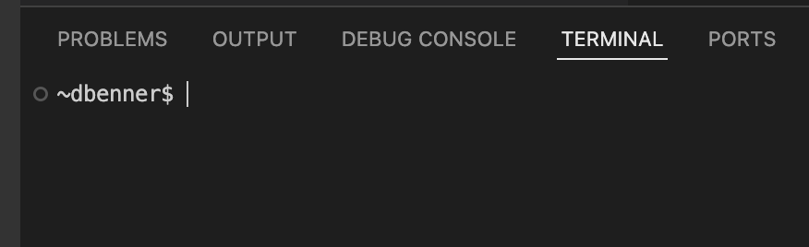
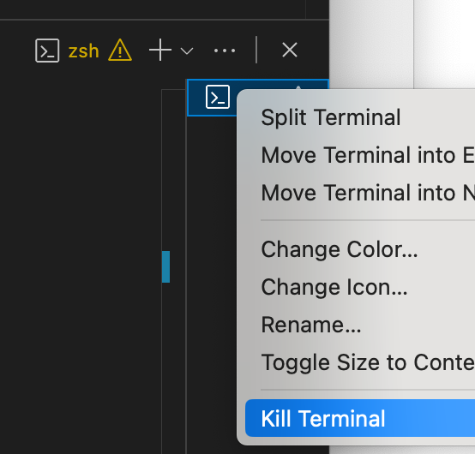
VS Code
Warm up 2
STEP #1:
From VS Code application menu select Terminal > New Terminal
STEP #2:
On the command line of your terminal type pwd and press enter.
This terminal command stands for present working directory and is how you tell what folder you are in when working with the terminal.
STEP #3:
Let’s close the terminal now. Right click the terminal tab selector and choose Kill Terminal Yes, you can have more than one terminal open at a time.
VS Code let’s us access your laptop’s terminal
Notes:
Notice that when you open a terminal the present working directory is the folder you have selected in the Explorer pane.

Slide 11
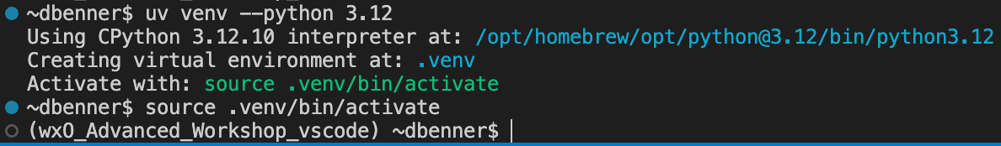
VS Code
Warm up 3
STEP #1:
Open a new terminal with Terminal > New Terminal
STEP #2:
On the terminal’s command line type uv sync and hit enter.
What you are doing is using the uv command to add a virtual environment to the wxO_Advanced_Workshop folder
Note: There are many ways to accomplish getting a python virtual environment setup. We just want to expose you to a potentially new one with the uv command.
STEP #3:
Now let’s activate the virtual environment by typing this command in the terminal source .venv/bin/activate and hit enter.
VS Code let’s us use command line tools like UV to make a python virtual environment.
Notes:
It’s totally OK to have several virtual environments on your laptop to keep your python project dependencies

Slide 12
Let’s warm up on ADK commands

Slide 13
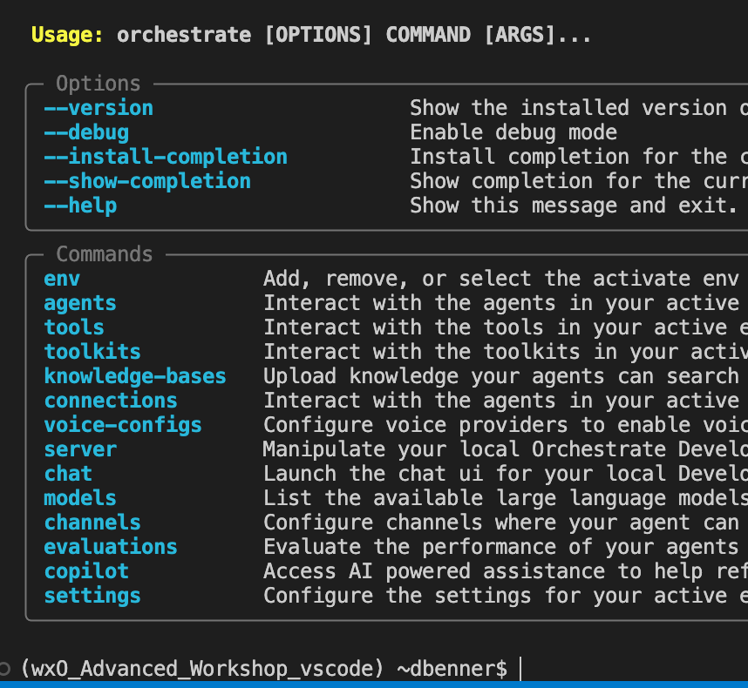
ADK
Warm up 1
STEP #1:
Let’s see all the commands that the ADK has available. Type orchestrate –help then hit enter.
STEP #2:
Now let’s drill in on a specific command’s help menu. Type orchestrate agents --help then hit enter.
STEP #3:
Now try getting the help for the tools command using the techniques you just learned above.
Hint: don’t forget to form your command like this
orchestrate COMMAND –-help
STEP #4:
Let’s go down the rabbit hole. Get the help menu for using import command with agents command.
Hint:
orchestrate COMMAND COMMNAD --help
ADK let’s us use “pro code” tools to develop agents in wxO.

Slide 14
Let’s do a lab!

Slide 15
Lab – Welcome to the ADK
Tee up the Chat with documents lab
Key points
Define agent in yaml format
Upload documents to start chatting with them
Anti patterns
Don’t use the wrong tools to do something
Uploading an excel document is not the best idea. A better idea is to use a tool for this job.

